Slide 1
Validating What OCR Actually Extracted
Module 1 produces a markdown file and says it's done. This module asks: is it actually right?
.md
✓
Identification · Validation · Root Cause Analysis

Slide 2
VIDEO SERIES
Part of a Series: How to Build Your First Chatbot
Real documents, real models, real measured results — not toy examples.
1
OCR & Document Understanding
PDF → structured markdown
2
Analysis & Validation
Is the extraction actually right?
YOU ARE HERE
3
Chunking
Splitting documents for retrieval
4
Embedding & Database
Vectors, Postgres, pgvector
5
Database Deep Dive
Search, indexes, and what Postgres actually does
6
Summarization
Retrieval + a real LLM + a UI
Series context reproduced from the provided Module 2 deck.

Slide 3
VALIDATION METHODOLOGY
VALIDATION METHODOLOGY
How We Validate OCR Quality
Sample across document structures → measure extraction signals → analyze statistically → inspect what looks wrong.
1 BUILD A REPRESENTATIVE SAMPLE
2 TURN THE SAMPLE INTO EVIDENCE
Do not validate only the easiest PDFs. Sample documents across the structures present in the corpus.
1
MEASURE
tokens/page · confidence · dropped regions · artifacts
2
ANALYZE
mean / median · spread · distributions · structure-wise rates
TEXT-HEAVY
TABLES
3
FIND OUTLIERS
unusually low/high density · missing content · malformed regions
FORMS
MULTI-COLUMN
4
VALIDATE
inspect a sample + flagged cases and decide if output is trustworthy
SCANNED / MIXED
This makes the validation set reflect the actual variety of the corpus.
EXPECTED RANGE
NORMAL VARIATION
LOW
HIGH
The goal is not one “correct” number — it is evidence that the OCR behaves consistently across the document population.

Slide 4
HOW THIS HELPS
Three Things This Module Actually Buys You
01
02
03
IDENTIFICATION
VALIDATION
ROOT CAUSE
Find the documents most likely to have extraction problems — from metrics alone.
Decide whether a completed document is trustworthy enough to move downstream.
Trace a bad result back to the exact page and region that caused it.
Same underlying evidence → three different human decisions

Slide 5
OVERVIEW
What This Module Does
One pass turns raw OCR output into a validation workbook a human can scan quickly.
1
2
3
4
READ
MEASURE
FLAG
REPORT
markdown + metadata
tokens · pages · layout
uncertain / dropped / malformed
Excel summary + detail sheets
The workbook becomes the quality gate between OCR and chunking.

Slide 6
TEACHING BUILD
From “files exist” to “evidence exists” · Step 1 of 3
Use these three slides as a click-through build while teaching the validation pipeline.
MODULE 1 OUTPUT
ANALYSIS MODULE
VALIDATION WORKBOOK
document.md
TOKENS / PAGE
≈ 510
Summary
Low Confidence
metadata.json
LOW CONF.
2
Dropped Regions
regions.json
DROPPED
1
Artifacts Detail
Step 1: Module 1 produced files. That only proves the run completed.

Slide 7
TEACHING BUILD
From “files exist” to “evidence exists” · Step 2 of 3
Use these three slides as a click-through build while teaching the validation pipeline.
MODULE 1 OUTPUT
ANALYSIS MODULE
VALIDATION WORKBOOK
document.md
TOKENS / PAGE
≈ 510
Summary
Low Confidence
metadata.json
LOW CONF.
2
Dropped Regions
regions.json
DROPPED
1
Artifacts Detail
Step 2: Analysis converts those files into comparable quality signals.

Slide 8
TEACHING BUILD
From “files exist” to “evidence exists” · Step 3 of 3
Use these three slides as a click-through build while teaching the validation pipeline.
MODULE 1 OUTPUT
ANALYSIS MODULE
VALIDATION WORKBOOK
document.md
TOKENS / PAGE
≈ 510
Summary
Low Confidence
metadata.json
LOW CONF.
2
Dropped Regions
regions.json
DROPPED
1
Artifacts Detail
H
Human checks
exact page + bbox
Step 3: Flags land in a workbook that tells a human exactly where to look.

Slide 9
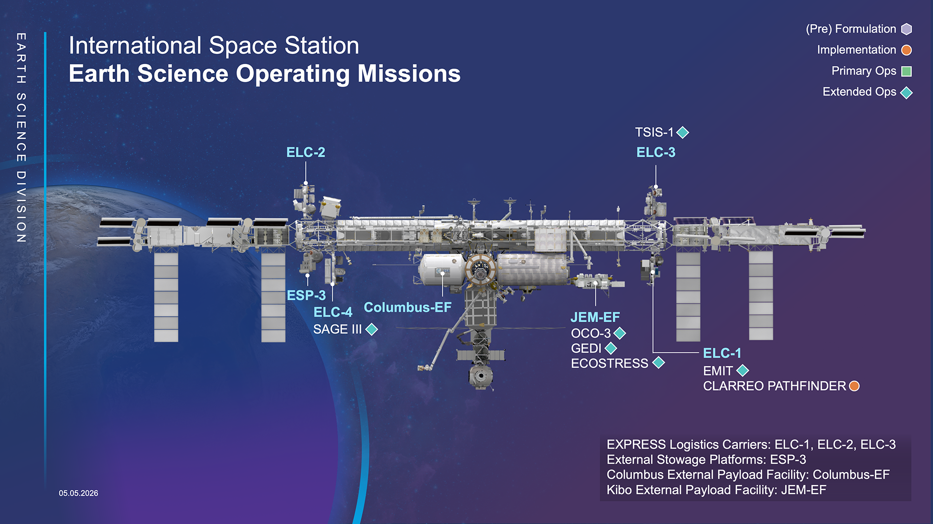
REAL NUMBERS
Tokens Per Page, Three Real Documents
Content density tells you more than raw document length.
NASA ISS factsheet visual context
Despite 2 pages, this document averaged only 247.5 tokens/page in the measured corpus.
Data: provided Module 2 deck. Image: NASA Headquarters, “NASA Science Facilities on the International Space Station,” https://svs.gsfc.nasa.gov/30280

Slide 10
LAYOUT ANALYSIS
The Other Half of Validation
Token analysis and layout analysis answer two independent questions.
HOW MUCH CAME OUT?
DID IT SEE THE PAGE CORRECTLY?
TOKEN ANALYSIS
LAYOUT ANALYSIS
1
token count
1
low-confidence regions
2
tokens / page
2
dropped regions
3
density outliers
3
artifacts / malformed tables
Question: did enough content survive extraction?
Question: did the detector understand the page structure?

Slide 11
THE DELIVERABLE
One Workbook, Built for Validation
analysis_report.xlsx
WHY EXCEL?
Document
Tokens/page
Low conf.
Dropped
SCAN
50 rows quickly
federal_register
508.7
0
0
FILTER
show only flagged docs
synthetic_sample
513.0
1
1
TRACE
page + bbox for every finding
nasa_iss_factsheet
247.5
2
0
HAND OFF
usable by non-pipeline authors
Summary
Artifacts Detail
Low Confidence
Dropped Regions

Slide 12
ROOT CAUSE ANALYSIS
Tracing a Dropped Region Back to a Real Bug
A useful flag always carries a route back to the page that created it.
1
WORKBOOK FLAG
2
JUMP TO BBOX
3
CONFIRM THE BUG
REPORT
Visible logo
page 1 · dropped region
confidence 0.31
Quarterly operations
summary text…
misclassified as page furniture
The report says exactly where to inspect.
LOGO
bbox
hidden bug → traceable bug
Schematic page reconstruction for teaching — not the original source image.

Slide 13
HUMAN-IN-THE-LOOP, BY DESIGN
A Flag Is Only Useful If Someone Can Act On It
WORKBOOK
HUMAN
stores page + bbox
checks exact spot
DETECTOR
DECISION
flags uncertainty
confirm / clear
Feedback / next pipeline fix
The key design choice: the workbook does not merely say “something is wrong” — it points to the exact region a person should inspect.

Slide 14
A VALIDATION HABIT
Tokens/Page as an Anomaly Signal
There is no universal “correct” number — the useful signal is deviation from peers.
510
LOW
HIGH
Much lower than peers
Much higher than peers
Possible missed / truncated content
Possible duplication / garbled extraction

Slide 15
THE SCALING PROBLEM
Reviewing Everything Doesn’t Scale
5000
500
50
3
Teaching corpus
Small batch
Team scale
Production scale
Manual review effort grows with corpus size — so validation needs a triage rule, not heroic rereading.

Slide 16
STEP 1: TARGETED REVIEW
Full Coverage Where It’s Cheap
FLAGGED BUCKET
Why this stays affordable
100%
The model already told you where it is unsure.
✓
review every document with
low confidence · dropped region · malformed table
✓
The flagged bucket is typically much smaller than the whole corpus.
✓
You get maximum scrutiny exactly where expected risk is highest.

Slide 17
STEP 2: RANDOM AUDITS
Catching What the Model Didn’t Flag
CLEAN BUCKET
Why audit “clean” documents?
5–10%
A validator that only checks its own doubts can never discover its own blind spots.
random audit starting point
Audit hit rate becomes evidence about whether “zero flags” is actually trustworthy.

Slide 18
PUTTING IT TOGETHER
A Simple Sampling Rule
Methodology — not a result from the three-document teaching corpus.
Any flags?
low confidence / dropped / malformed
NO
NO
DOCUMENT
Tokens/page outlier?
YES
YES
REVIEW 100%
REVIEW
AUDIT
5–10%
If audits keep finding real issues → raise the clean-bucket audit rate until the hit rate falls.

Slide 19
A QUIET DETAIL
Partial Runs Get Skipped, Not Guessed At
✓
FINISHED
complete extraction → analyze
…
IN PROGRESS
output incomplete → wait
×
INTERRUPTED
output incomplete → skip
Validation should never invent certainty from incomplete evidence.

Slide 20
WRAP-UP
Why This Module Matters
1
Execution ≠ correctness
A completed run only proves the pipeline did not crash.
2
Two independent checks
Tokens tell you how much came out; layout tells you whether the page was understood.
3
Traceable flags
Every useful finding carries a page + bounding box back to the source.
4
Human review that scales
100% of flagged docs + audits of clean docs + tokens/page outliers.
5
Next: chunking
Only validated content should become retrieval-ready chunks.
Module 1 extracts → Module 2 validates → Module 3 chunks

Slide 21
SOURCES
Internet Visuals & Technical References
1
Qwen3.5-0.8B model / tokenizer
Qwen on Hugging Face
https://huggingface.co/Qwen/Qwen3.5-0.8B
2
International Space Station visual
NASA Scientific Visualization Studio · ID 30280
https://svs.gsfc.nasa.gov/30280
3
Measured metrics, case studies, and methodology
Provided Module 2 Analysis deck
Analysis_Module_Overview.pptx
No AI-generated imagery is used in this deck. Diagrams are native PowerPoint shapes; the NASA visual is sourced from NASA.

Slide 22
Questions?
2. ANALYSIS/ — README.md has the full column-by-column report reference and every real number in this deck.
Module 2 · Data Processing → Analysis → Chunking

